Slide 1

THE Q3/2024 PERFORMANCE

Slide 2

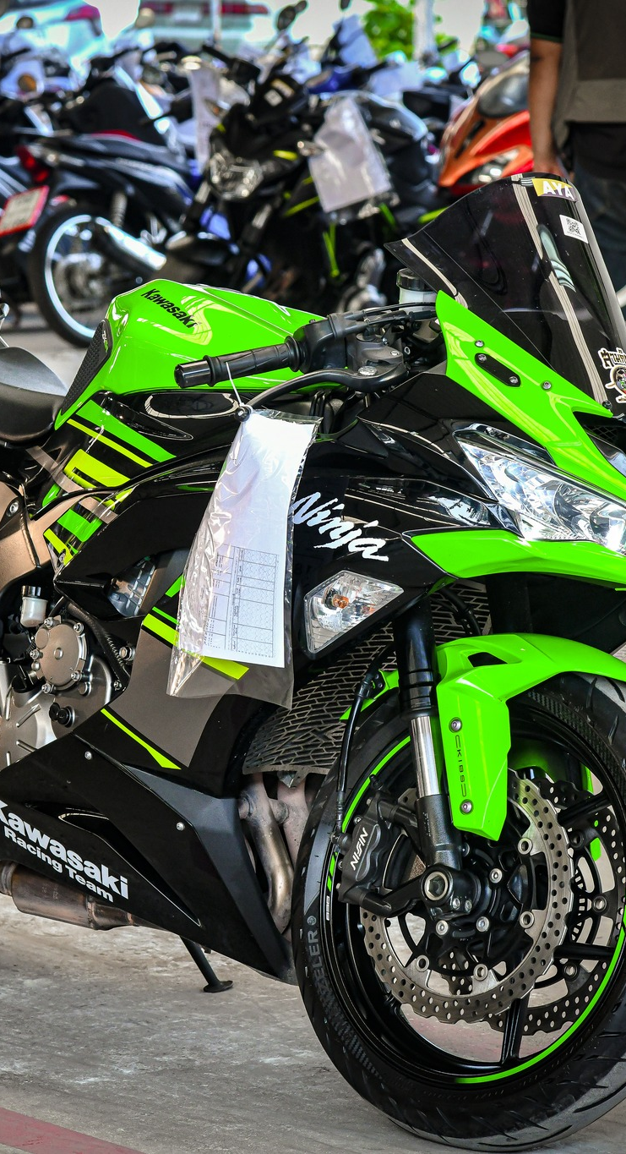
Business overview
Performance
Q&A

Slide 3













































































































































































































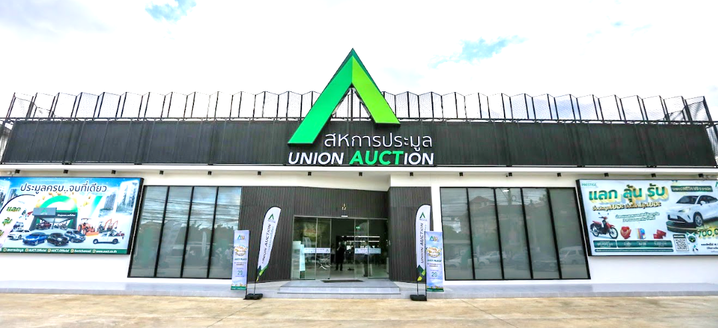




































































































































AUCT’s Development
1991
1998
2003
2012
AUCT Established
AUCT was appointed by the Financial Sector Restructuring Authority (FRA) to conduct the public auctions of vehicles and assets of insolvent finance companies.
AUCT launched the first mobile auction in the upcountry.
AUCT transformed into a public company.
2013
2017
2015
The Company started trading shares in MAI for the first time on 9 August 2013.
2021
Other auctions;
brand name, real estate
Organize auctions for government agencies; the Customs Department, NSO, AMLO, NBTC.
Re-banding
Developed E-AUCTION system at auction yard
Developed “AUCT BID” system
Added transportation service after auction
2022
2023
2024
AUCT Place
AUCT Garage

Slide 4

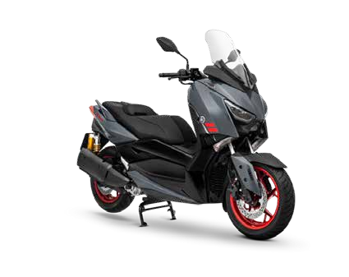

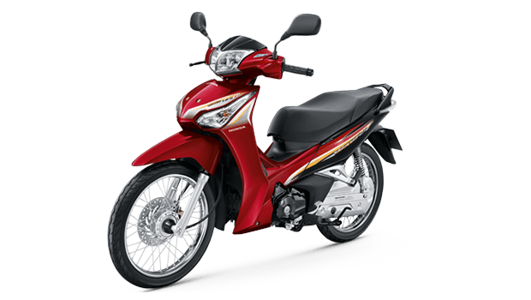


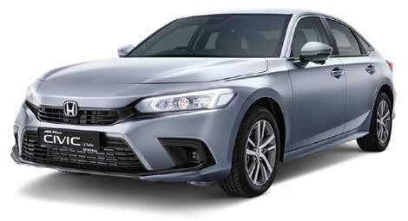

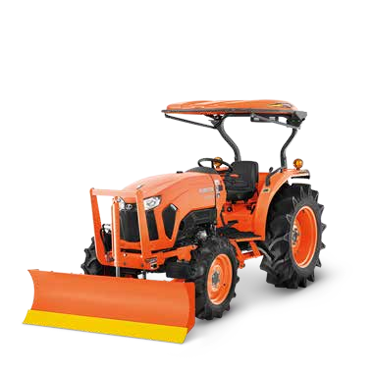
Nature of business
Cars
Motorcycles
Agricultures
Others
Real estate
Band name
Electrical appliances

Slide 5
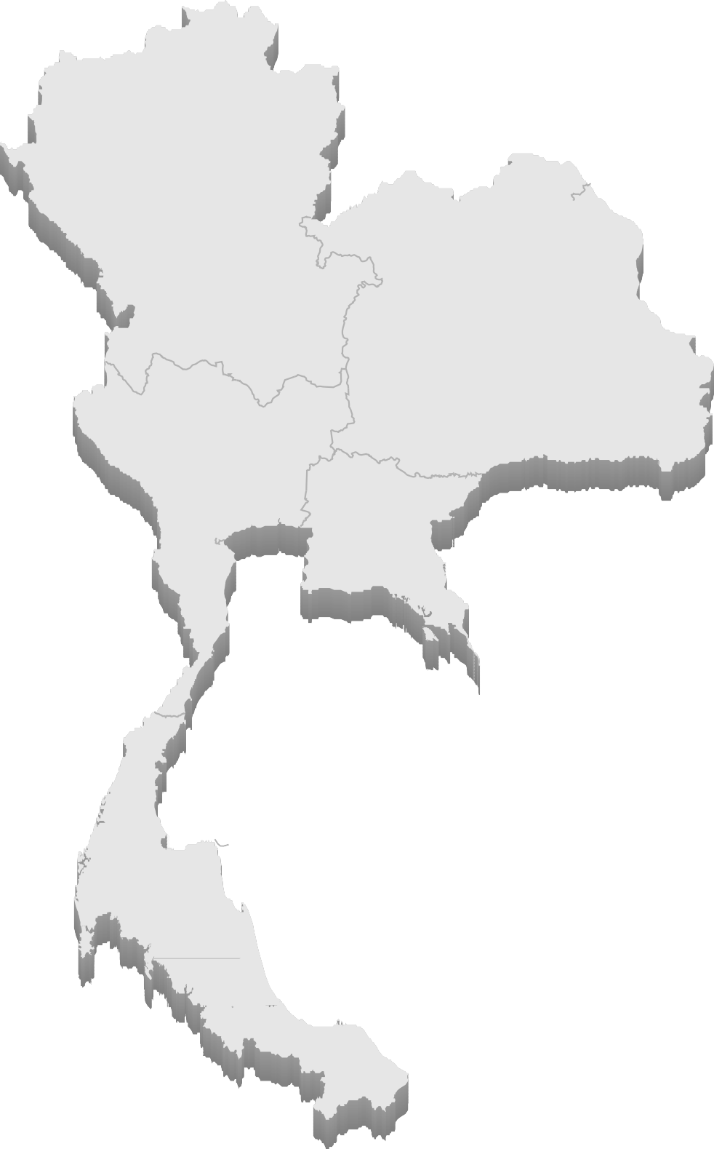


Areas
Northeast Warehouses
NakhonRatchasrima: Muang
NakhonRatchasrima: Pakchong
Ubon Ratchathani
Udon Thani
Khon Kaen
Surin
Roi Et
Sakon Nakhon
Si Sa Ket
Kalasin
Buriram
Nong Khai
Loei
Chaiyaphum
North Warehouses
North Auction Houses
Chiang Mai
Phitsanulok
Nakhon Sawan
Phetchabun
Chiang Rai
Lampang
Kamphaeng Phet
Chiang Mai
Phitsanulok
Northeast Auction Houses
NakhonRatchasrima
Ubon Ratchathani
Udon Thani
Khon Kaen
Central Warehouses
Central Auction Houses
Bangkok
Pathum Thani
Saraburi
Ayutthaya
Samut Sakhon
Ratchaburi
Suphan Buri
Bangkok
Pathum Thani
Ratchaburi
Eastern Warehouses
South Warehouses
Rayong
Chonburi: Pattaya
Chonburi: Ban Bueng
Sakaeo
Prachin Buri
Chantaburi
Surat Thani
Songkhla
Prachuap Khiri Khan
Chumphon
Nakhon Si Thammarat
Phuket
Trang
Phang-nga
Krabi
43 Warehouses 13 Auction Houses
South Auction Houses
Eastern Auction Houses
Surat Thani
Songkhla
Rayong
Chonburi

Slide 6











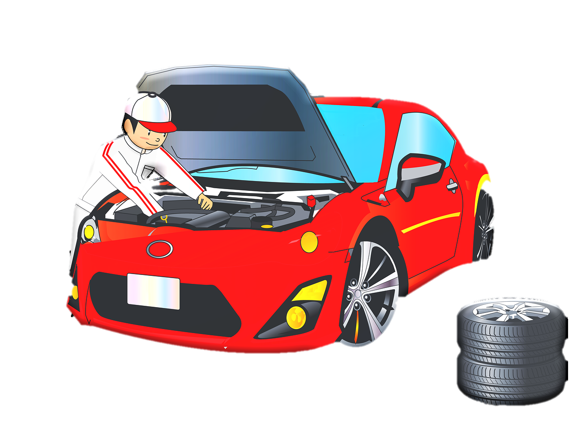

Auction Flow
Pay the rest within 3 days

⬥
Get car registration book
Confirm & Payment 10%
AUCTION
❖
◆
Receive vehicles
into the warehouse
Waiting for redeem ~ 45 - 60 days
Move to Auction House
Record to system, Clarify, Cleaning, Upload to website, Auction

Slide 7
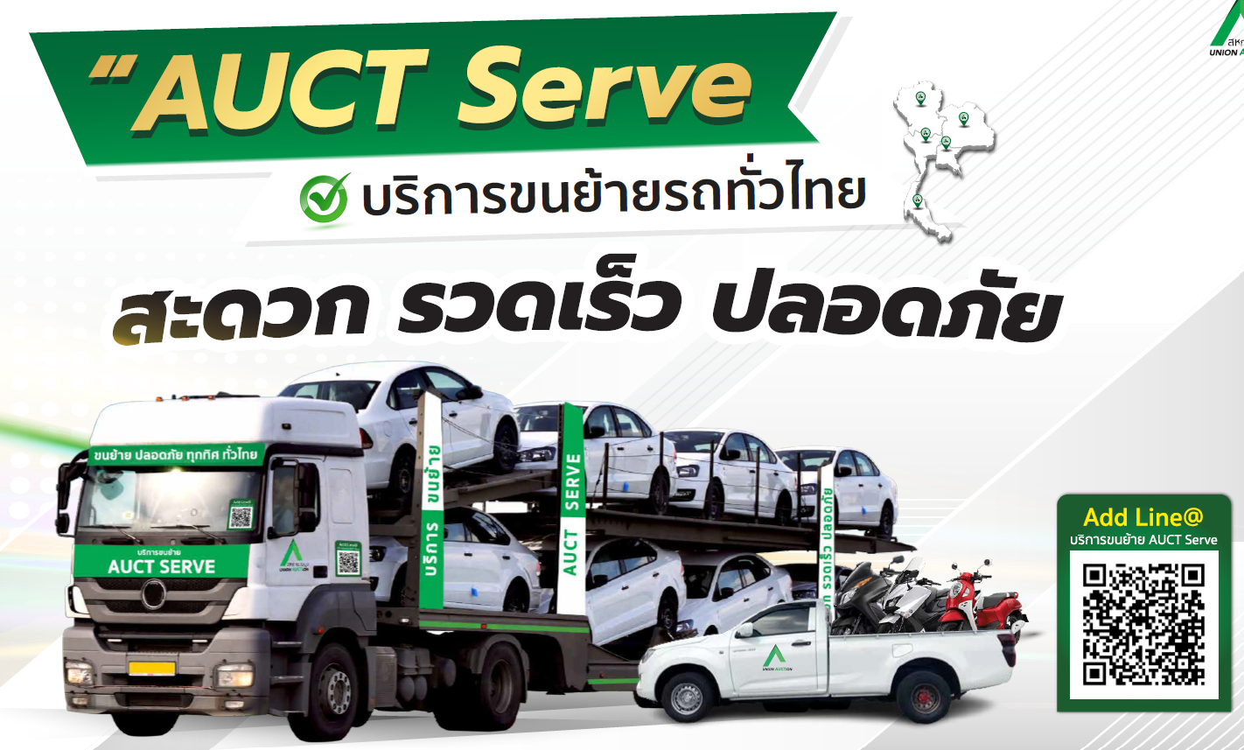


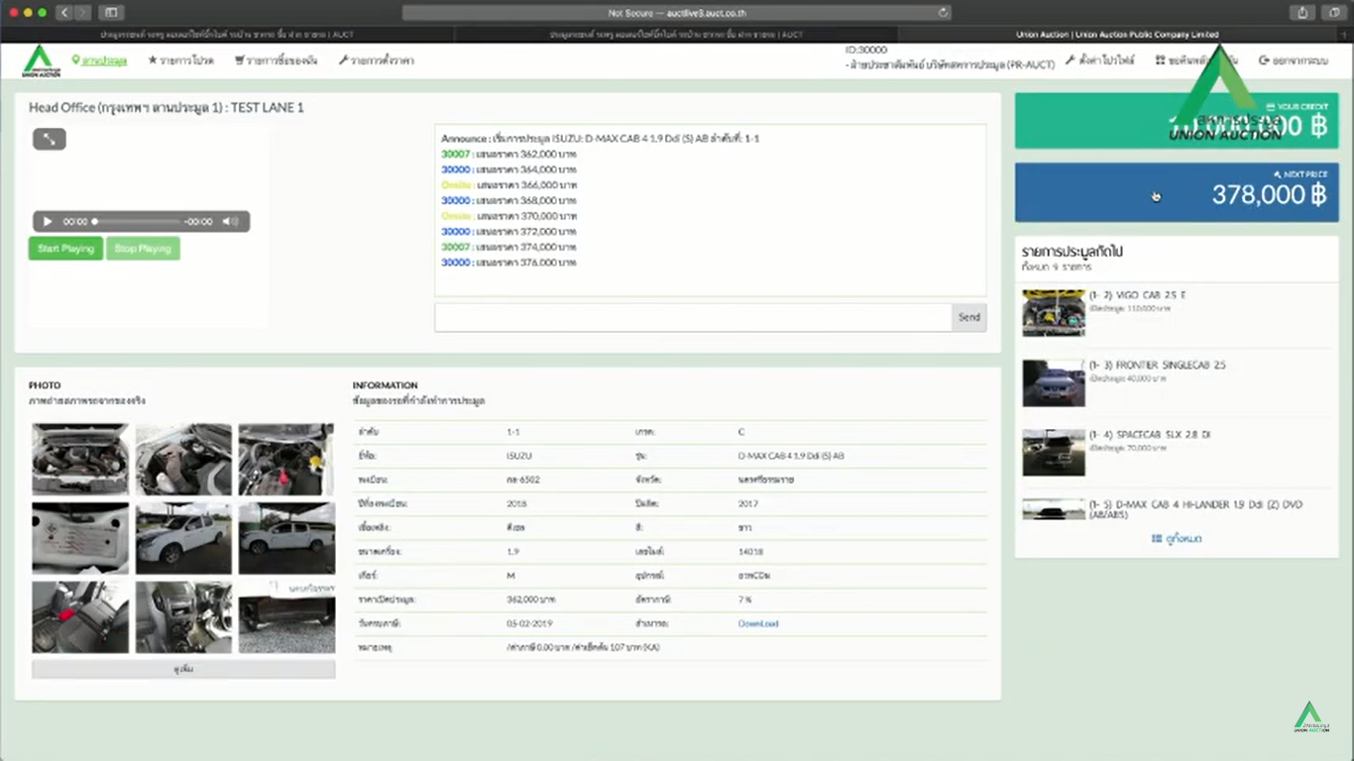



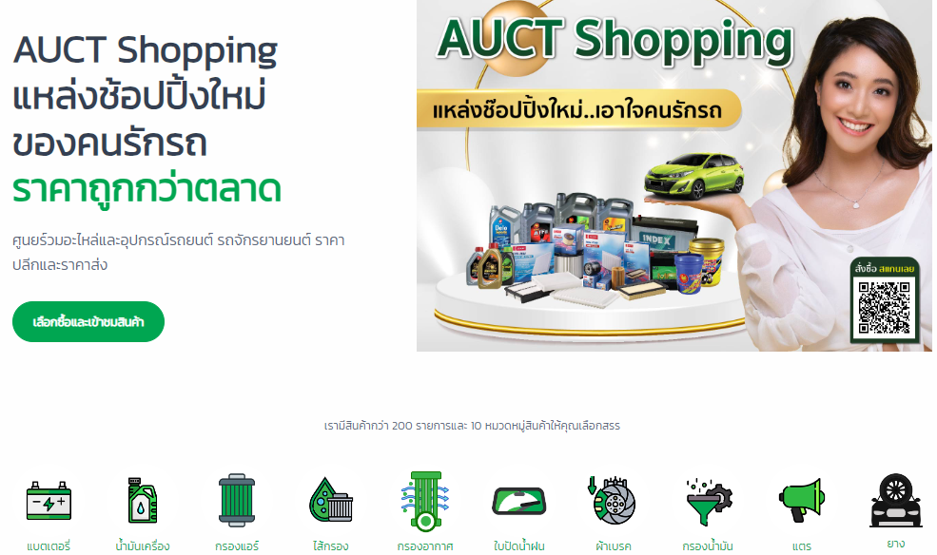
Our services
AUCT SERVE
AUCT Finn
AUCT BID
AUCT LIVE
AUCT Garage
AUCT Property
AUCT SHOPPING

Slide 8




























Partners & Clients
Financial Institutions
Insurances
Government agencies

Slide 9

Business overview
Performance
Q&A

Slide 10
Q3/2024 Financial Highlight
Total revenues
(0.2%) YoY
6.3% QoQ
Gross profit
(0.6%) YoY
9.1% QoQ
Net profit
(0.9%) YoY
11.5% QoQ
Total Assets
(1.4%) from 2023
Total Liabilities
5.2% from 2023
ROA
= 1.94%
ROE
= 17.94%
D/E
= 0.62 times

Slide 11

Q3/2024 Performance
Revenue
Expense
(Unit: Million Baht)
(Unit: Million Baht)
1,240.61
26.4%
804.55
30.2%
8.2%
4.2%
953.19
981.86
636.27
613.91
901.69
907.75
588.96
579.63
0.9%
-0.2%
211.35
213.33
328.63
327.98
2021 2022 2023
2021 2022 2023

Slide 12
Q3/2024 Performance
Net Profit
Gross profit
(Unit: Million Baht)
(Unit: Million Baht)
2021 2022 2023
2021 2022 2023

Slide 13





Q & A
auct.official
สหการประมูล
https://www.facebook.com/AUCT.Official
Disclaimer: This information is prepared by Union Auction Public Company Limited aims to publicize company’s information to investors for only investment decision support which do not aim to persuade for company’s securities trading. The investors should consider for above presented carefully for taking decision. The Company will not responsible for any disadvantages as claimed to cause of these information for decision support. If the investors require additional information, please find via The Office of The Securities and Exchange Commission (SEC) and Stock Exchange of Thailand (SET). The Company reserved for this information edition or addition in this website without inform to investors in advanced. Also do not allow any person to duplicate, modify or publicize to public for all or some without permission from the Company.

